Slide 1




ASP.NET REST Services
ASP.NET REST
Services
SoftUni Team
Technical Trainers
Software University
http://softuni.bg

Slide 2

Table of Contents
Web API Documentation
ASP.NET Identity API

Slide 3
Have a Question?
sli.do #CSharpWeb

Slide 4
Web API Documentation
XML
XML
XML

Slide 5
Web API Documentation
An API is only as good as its documentation.
Easily generated with HelpPage package
By default accessible on <host>/Help
Notes:
Documentation
An API is only as good as its documentation. The docs should be easy to find and publically accessible. Most developers will check out the docs before attempting any integration effort. When the docs are hidden inside a PDF file or require signing in, they're not only difficult to find but also not easy to search.
The docs should show examples of complete request/response cycles. Preferably, the requests should be pastable examples - either links that can be pasted into a browser or curl examples that can be pasted into a terminal. GitHub and Stripe do a great job with this.
Once you release a public API, you've committed to not breaking things without notice. The documentation must include any deprecation schedules and details surrounding externally visible API updates. Updates should be delivered via a blog (i.e. a changelog) or a mailing list (preferably both!).
http://www.vinaysahni.com/best-practices-for-a-pragmatic-restful-api

Slide 6
Documentation – Steps (1)
Annotate the controller or action that you want to make documentation for.
//<summary>Sample controller documentation</summary>
public class ValuesController : ApiController
{
//<summary>Sample GET method returning collection </summary>
//<returns>Several sample values</returns>
public IEnumerable<string> Get()
{
return new string[] { "value1", "value2" };
}
}

Slide 7
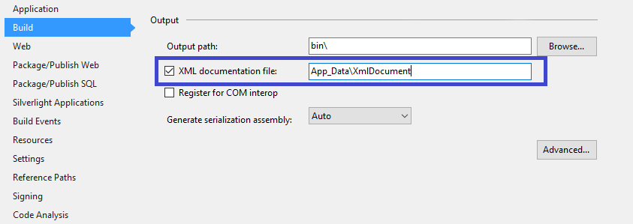
Documentation – Steps (2)
Open the properties of you web project and open the Build tab

Slide 8
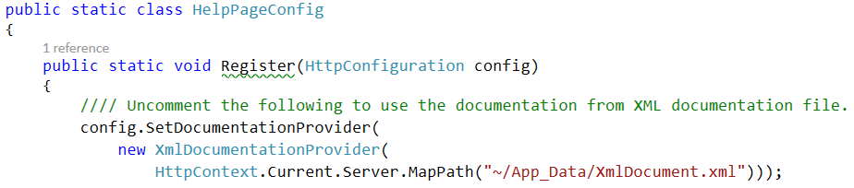
Documentation – Steps (3)
Open the HelpPageConfig in the Areas --> HelpPage --> App_Start an uncomment the first line

Slide 9
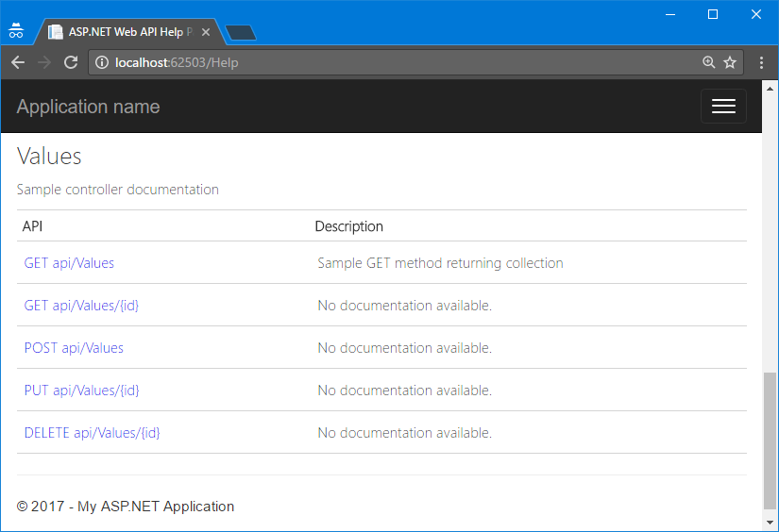
Documentation – Steps (4)
Open the help page in your web application

Slide 10



ASP.NET Identity API
Setup, Registration, Login, Logout

Slide 11
ASP.NET Identity
Authentication and authorization system for ASP.NET Web apps
Supports ASP.NET MVC, Web API, Web Forms, SignalR, Web Pages
Handles users, user profiles, login / logout, roles, etc.
Based on the OWIN middleware (can run outside of IIS)
Automatically integrated when the Individual User Accounts option is selected on Web API project creation

Slide 12


Identity Authentication (Login)
POST localhost:55602/Token
Username | motikarq@gmail.com
Password | 1234567
grant_type | password
localhost:55602
200 OK
access_token | 22k_HP6fSFwsQ88L3_JQh9nnx3…
token_type | bearer
expires_in | 1209599
userName | jamal@hussein.com
.expires | Thu, 27 Aug 2015 12:42:38 GMT
Sent in future requests' headers for authentication

Slide 13
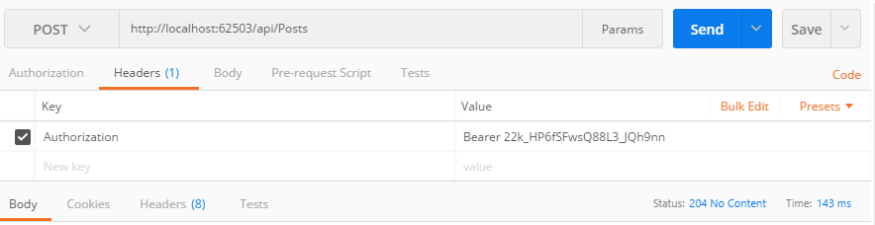
Request Authentication
Access token should be put in request headers

Slide 14
ASP.NET Authorization
Use the [Authorize] and [AllowAnonymous] attributes to configure authorized / anonymous access for controller / action
[Authorize]
public class AccountController : ApiController
{
// GET: /account/login (annonymous)
[AllowAnonymous]
public IHttpActionResult Login(LoginBindingModel model) { … }
// POST: /account/logout (for logged-in users only)
[HttpPost]
public IHttpActionResult Logout() { … }
}

Slide 15
Check the Currently Logged-In User
// GET: /users/gosho (for logged-in users only)
[Authorize]
public IHttpActionResult GetUserInfo()
{
string currentUserId = this.User.Identity.GetUserId();
if (currentUserId == null)
{
return this.Unauthorized("Access denied");
}
...
}

Slide 16
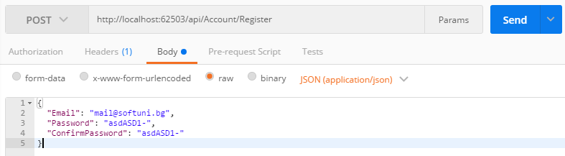
Postman Authentication

Slide 17
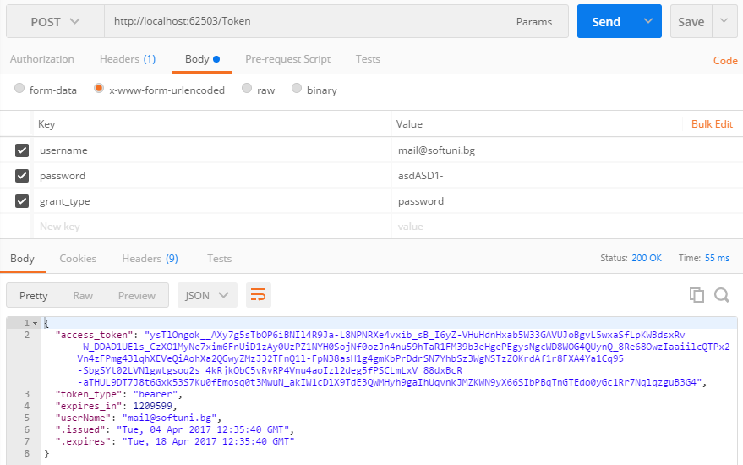
Postman Authentication (2)

Slide 18
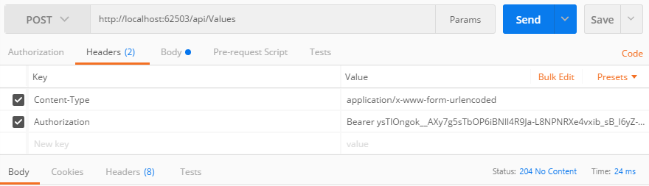
Postman Authentication (3)

Slide 19
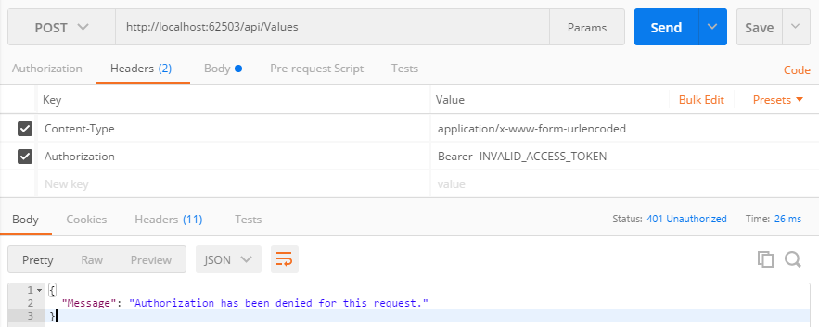
Postman Authentication (4)

Slide 20








ASP.NET Web API Introduction
https://softuni.bg/courses/

Slide 21
License
This course (slides, examples, demos, videos, homework, etc.) is licensed under the "Creative Commons Attribution-NonCommercial-ShareAlike 4.0 International" license
Attribution: this work may contain portions from
"Web Services and Cloud" course by Telerik Academy under CC-BY-NC-SA license

Slide 22






Free Trainings @ Software University
Software University Foundation – softuni.org
Software University – High-Quality Education, Profession and Job for Software Developers
softuni.bg
Software University @ Facebook
facebook.com/SoftwareUniversity
Software University @ YouTube
youtube.com/SoftwareUniversity
Software University Forums – forum.softuni.bg

